Slide 1
Practice: Logisim Ⅱ (Week 4)

Slide 2


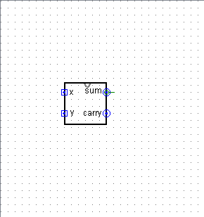
Edit appearance
You can edit circuit’s subcircuit appearance

Slide 3
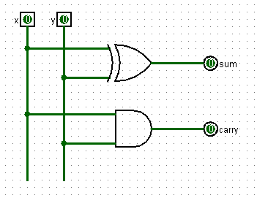
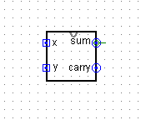
Labeling
You should label for every inputs & outputs

Slide 4
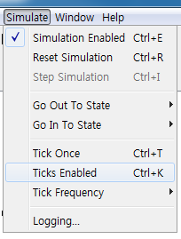
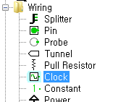
Clock
Add a clock
You can enable the clock and change the clock frequency

Slide 5
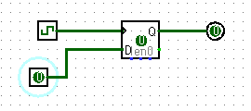

Clock
Test a D flip-flop with a clock
Rising edge & falling edge

Slide 6
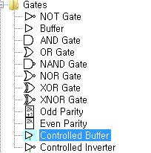
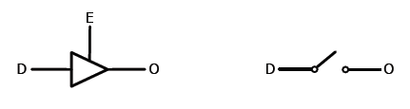
Tristate Buffer
Controlled buffer in Logisim
When E = 1, the output O follows the input D
When E = 0, the output O is in Hi-Z

Slide 7
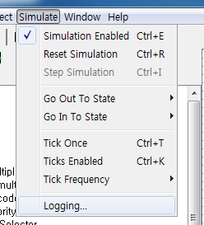
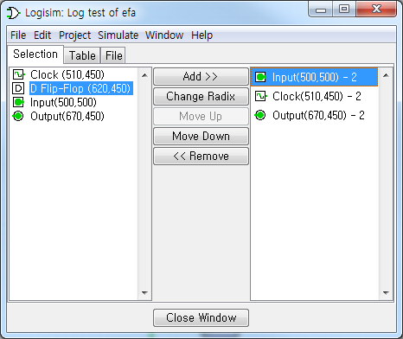
Logging
You can check the previous input & output by using the logging module

Slide 8
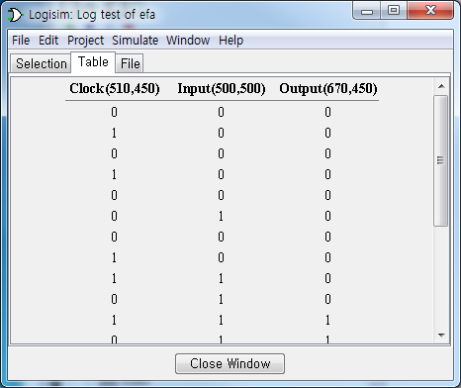
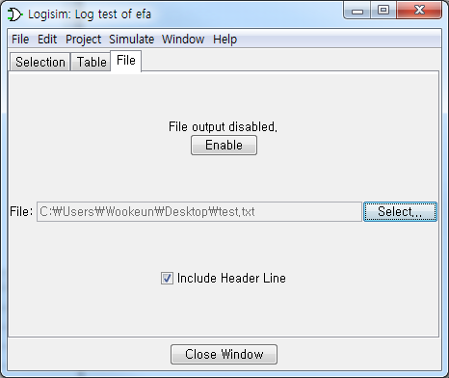
Logging
The ‘Table’ tab shows the previous input and corresponding output of the circuit
Also, you can save them to a file

Slide 9
Practice

Slide 10
Practice 1
Make a 4bit Shifter
You can use built-in 4-to-1 Multiplexer
refer to lecture note 03
Notes:
Next chapter, Ealier Technology, will be helpful to understand SASMvm more easily.

Slide 11
Practice 2
Make a 1bit Register
You can use built-in D-flip-flops & Multiplexer
Make a 4bit Register
You have to use 1bit Register you made
Notes:
Next chapter, Ealier Technology, will be helpful to understand SASMvm more easily.

Slide 12
Practice 3
Make a 2-to-1 multiplexer using tristate buffer

Slide 13
Practice 4
Make a Memory Cell
You can use 1 And gate, 1 D flip-flop, 1 Tristate buffer
Make a 4x4 RAM
you have to use memory cell you made

Slide 14
Practice submission
오후 11시까지 각 Practice 파일을 dccpta@aces.snu.ac.kr 로 제출
0403_이름_practice(번호).circ의 형식으로 총 4개의 파일을 제출
파일명 다를 경우 무효처리
과제 미제출시 실습수업 결석
Notes:
Next chapter, Ealier Technology, will be helpful to understand SASMvm more easily.

